Slide 1
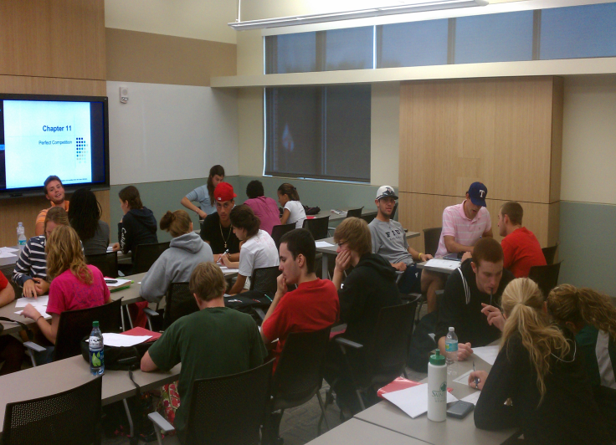
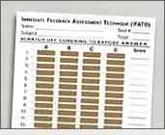

Using IF-AT Cards in Principles Classes for Group Quizzes
Patrick Ryan Murphy
Assistant Professor of Economics
Saint Leo University

Slide 2
What are IF-AT Cards?
IF-AT = Immediate Feedback Assessment Technique
A new multiple-choice assessment system
Allows instructors to give partial credit for “proximate” knowledge
  Basically it gives points for narrowing answers down to a or b
Provides immediate affirmation and/or corrective feedback
  System ensures that the last response is the correct one
  “Teaches while it assesses”
http://www.epsteineducation.com/home/Default.aspx

Slide 3
Card Design
Different options on length (10, 25, 50) and number of choices (4 or 5)
Score column on side allows total to be calculated & checked quickly
When using with groups, I usually have them write their names and score on back
Form # on bottom and corresponds to a specific key

Slide 4
Why use IF-AT?
“Millenials” Learning Preferences (Howard Carey)
  Expect interaction
  Gravitate toward group activities
  Venue to allow them to be heard and listened to
  They like new technology and constant feedback
IF-AT has a Top 10 reasons for using:
  I have found IF-AT to be fair, fun, and active
  Evidence shows IF-AT is effective and improves learning

Slide 5
Making Quizzes – 2 options
1) Cut and Paste to match keys provided
  Usually not too bad. When I started, I just tried to find a key that was somewhat close to the quizzes I had made
2) Use the “Testmaker” program
  Free – internet based program
  Questions and answers must be entered (see next slide)
  Quizzes can be saved and changed to match any key
    I really like this option…could make different quizzes for each class/semester

Slide 6
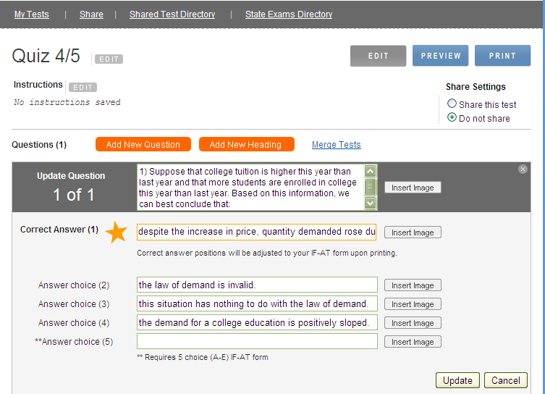

Slide 7
How to use IF-AT in groups
First 10 minutes are set for students to try to take the quiz alone, as if it were a test
  No notes, book, etc.
Next 10 minutes students group up (3-4 per group) and discuss their answers.
  Cards are distributed and groups must come up with 1 answer to scratch off until they find the correct answer.
  1 point for star on 1st attempt and ½ point for 2nd
Afterwards any tough questions and/or concerns are discussed

Slide 8
Instructions for students
A star will identify the correct answer
Star can be anywhere in the box, not just the middle!
  This is to prevent little scratches…which count as an attempt
Be careful to keep your place if you skip questions!
  Again scratches count as an attempt
Scratch with care to avoid tearing the form
  Note: This has been less of a problem w/ the new batch
  Plastic (ID cards) seems to be gentler than metal (coins)

Slide 9
Instructions for students
Ask me if you really think that an answer was right before moving on to next scratch
Make sure that everyone is participating in the group
  This is the whole point of the time spent on the quizzes
Don’t just take a quick count on who picked what OR flip a coin OR play paper-rock scissors!!!
  Debate/discuss WHY you picked what you did
  Show your work to your partners

Slide 10
Instructions for students
If you miss a question, go back and re-read the questions and discuss/debate again before next scratch
  b/c if it’s right on the second try it is worth ½ a point.
Do the same thing even if you miss twice (and will not get any points), because I want you to think about the choices and figure out why you missed it.
After you are finished, go back and make note of any questions that you would like discussed

Slide 11
Potential Problems/Solutions
“Millenials want to change the rules”
  “can we take tests like this”
  “I didn’t mean to scratch that box!”
  Solution: Must be clear before and firm right from the start
Free-rider problem
  Solution: You have to walk around and observe/encourage
Time consuming
  10 minutes alone then 10 minutes group
  Plus discussion time
    Note: I find it to be less than on quizzes without the IF-AT, because they have already figured out most questions missed
  Solution: I only use these every other chapter

Slide 12
Potential Problems/Solutions
Not a problem if students try to hold up to light
  …and yes they do
    “Man, these cards are well designed!”
Test Security issues
  There are multiple versions of every form (I have 8)
  Perforated tab on bottom can be removed
    But I don’t let them keep the cards, just the quizzes (which should not have the version/key noted on it!)
  You do have to keep an eye on them to make sure groups don’t cheat or share answers, but this has not been a big issue (most are competing with other groups)

Slide 13
Student Survey Results
Zoomerang survey* of 2 sections of Principles of Macroeconomics and 1 section of Microeconomics
  45/75 (60%) Visited
  34/75 (45.3%) Completed
  11 (32%) from Macro 10:30 am class
  9 (26%) from Macro 11:30 am class
  14 (41%) from Micro 1:30 pm class
    *Thank you to Laura Blasi!!!

Slide 14
Student Survey Results
Would you like other professors to use IF-AT quizzes in their class?
  28 (82%) Yes
  1 (3%) No
  5 (15%) Not sure

Slide 15
Student Survey Results
Which of the following best describes how you feel towards the time allowed on the quizzes? (please select the 2 that apply to you, one for group time and one for alone time) Note: some students did not respond to both parts, which is why sum is not 100%
  Time alone just right: 12 (36%)
  Need more time alone: 8 (24%)
  Need less time alone: 1 (3%)
  Time in groups just right: 13 (39%)
  Need more time in groups: 18 (55%)
  Need less time in groups: 0 (0%)

Slide 16
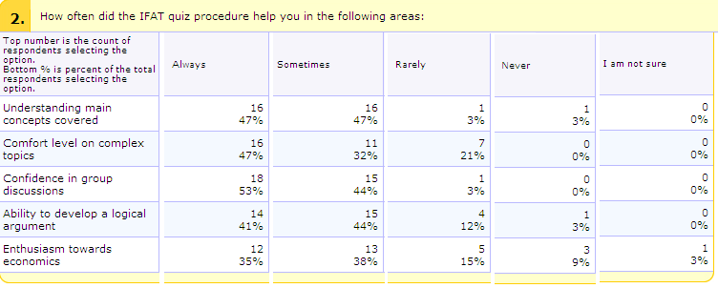

Slide 17
Student Survey Feedback
I also asked the following open-response questions:
  How are the IFAT quizzes different from quizzes in other classes?
  Discuss your best (and worst) experience with IFAT quizzes.
  Discuss why the time on the quizzes is worthwhile (or not worthwhile) to you.
  What is the one thing that could improve the experience for you?
  How would giving 1/4 point for getting the answer on the 3rd try affect you?
  How would the experience change if the quiz did not count for points towards your grade?

Slide 18
If you would like to try it…
1) No cost method
  Instead of scratch off cards, have them use index cards to write down answers and you can do a quick grade and have them retry any missed
    + No need to match to a key
    - A little more time consuming
    - Feedback is not as immediate
2) I have quizzes made for Macro and Micro that I will share if emailed (patrick.murphy@saintleo.edu)
  Chapters follow Colander’s 7th ed.

Slide 19
Sample IF-AT Quiz
10 Question sample quiz
IF-AT designed this quiz to be difficult, so you would miss some questions and see how the process works.

